Slide 1

Team Name : THE LEARNING CODERS
Team Leader Name : VENKATESWARI CHIMATA
Problem Statement : AI-Powered Marketplace Assistant for Local Artisans

Slide 2

Brief about the prototype:
The prototype is an AI-powered marketplace assistant designed to empower local artisans by simplifying their digital journey. Using Google Cloud’s generative AI, it enables craftsmen to create professional product descriptions, social media posts, and advertisements with ease. The platform focuses on storytelling, highlighting the cultural heritage and uniqueness of each craft to attract modern audiences. It also provides insights into market trends, helping artisans align their traditional skills with contemporary consumer preferences. Additionally, AI-driven recommendations guide them in pricing, packaging, and positioning their products effectively. The tool includes visual enhancement features to generate appealing images for online platforms, further boosting product visibility. Acting as a bridge between artisans and global buyers, the solution expands market access and income opportunities. By enhancing visibility and digital presence, it ensures sustainable growth and long-term success for artisans. Ultimately, this prototype preserves traditional art forms while empowering local craftsmen to thrive in the digital economy.

Slide 3
Opportunity should be able to explain the following:
The proposed AI-powered marketplace assistant offers a unique approach compared to existing solutions like generic e-commerce platforms or digital marketplaces, which mainly focus on product listings and transactions. Unlike these platforms, our solution is specially designed for local artisans, with features that simplify digital adoption through AI-generated product descriptions, marketing content, and visuals in multiple languages, making it accessible even to those with limited technical knowledge. It solves the core problems artisans face low digital visibility, lack of marketing skills, and poor connection with modern consumers by providing personalized recommendations for pricing, packaging, and trend alignment while also highlighting the cultural heritage behind every product. This ensures that artisans not only reach wider audiences but also maintain the authenticity of their craft. The USP of the solution lies in its ability to blend tradition with technology: it doesn’t just enable sales, but also tells the story of the craft, builds emotional connections with buyers, and creates sustainable income opportunities. By acting as both a marketplace enabler and a cultural storyteller, it secures the future of traditional art forms in the digital economy.

Slide 4
List of features offered by the solution
1.AI Product Cataloging – Auto-generate product listings, descriptions, and pricing suggestions.
2.Storytelling & Branding – Craft artisan stories, create brand pages, and multilingual support.
3.Digital Marketing – Social media content, email campaigns, and ad strategy recommendations.
4.Customer Engagement – AI chat assistant, feedback analysis, and AR/3D product previews.
5.Market Insights – Sales trends, customer behavior, and competitor analysis.
6.E-Commerce Integration – Online store setup, payment gateways, and inventory management.
7.Skill Development – Tutorials on marketing, photography, and design suggestions.
8.Community & Networking – Connect artisans, promote events, and engage customers.

Slide 5
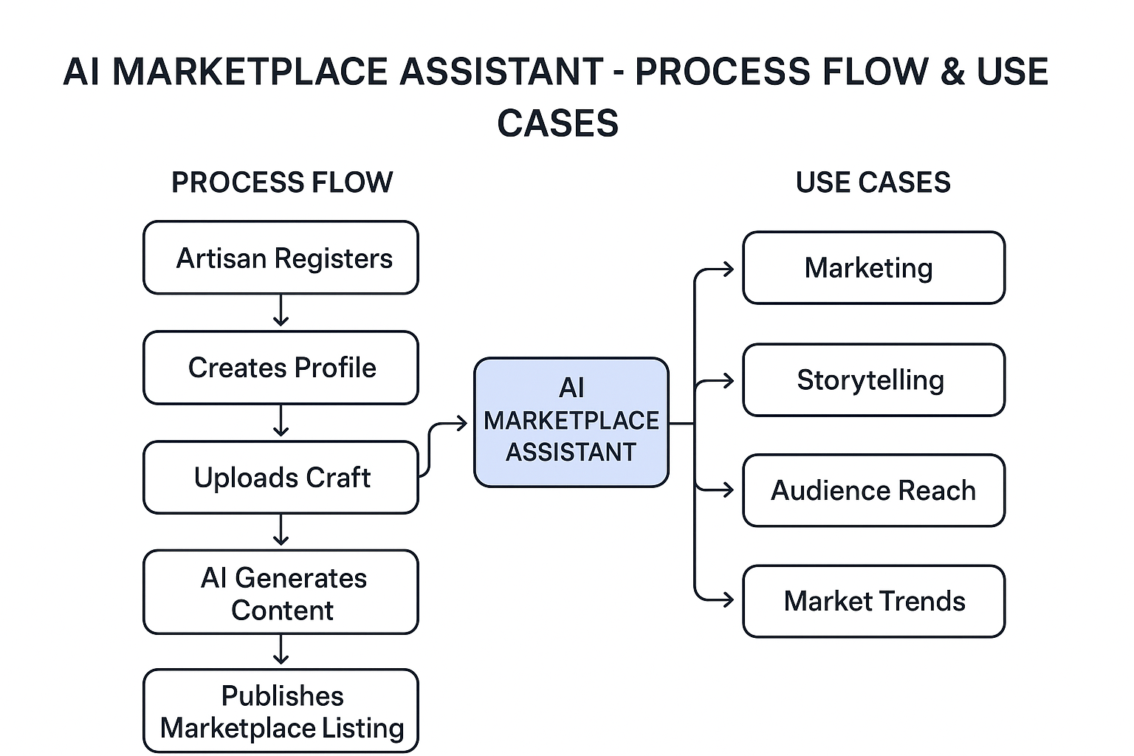
Process flow diagram or Use-case diagram

Slide 6
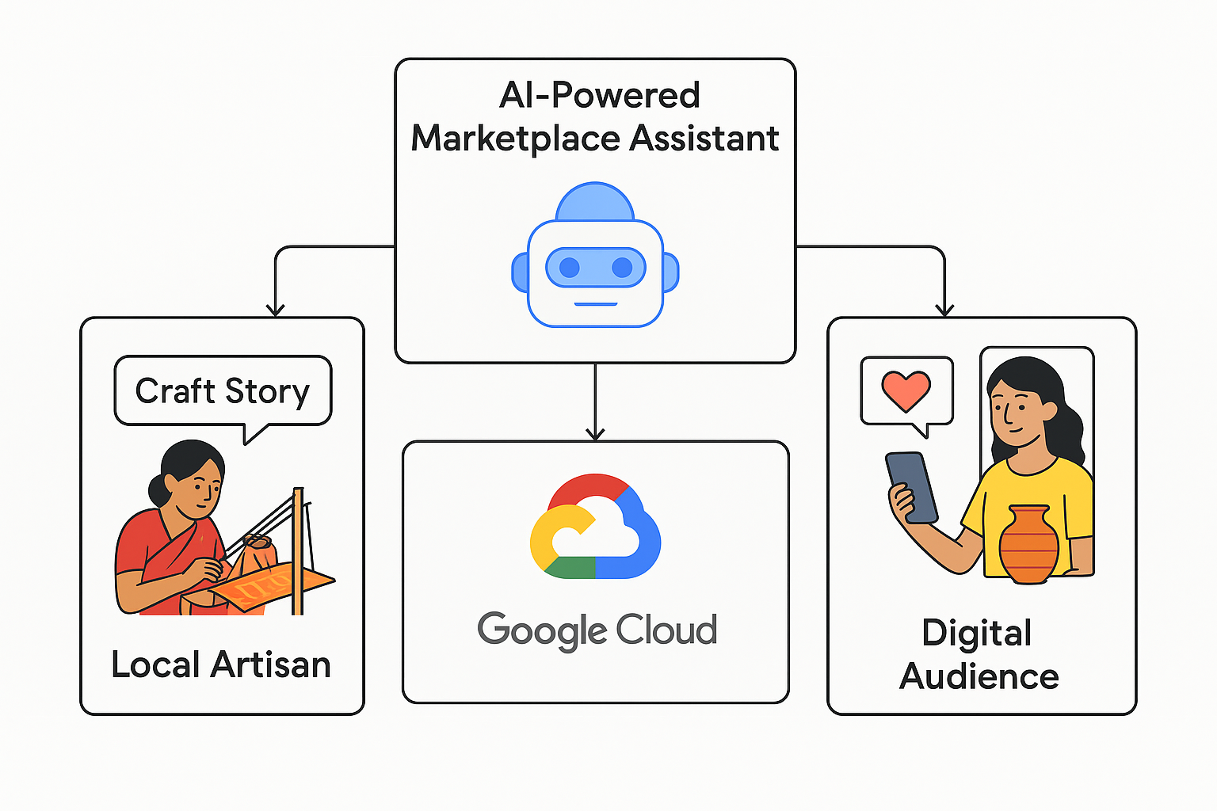
Architecture diagram of the proposed solution

Slide 7
Technologies to be used in the solution:
1. AI & ML
Generative AI (Google Cloud Vertex AI) for content, storytelling, and product images.
Recommendation systems for personalized product suggestions.
NLP for chatbots, feedback analysis, and customer support.
2. Cloud & Backend
Google Cloud (Storage, Functions, BigQuery) for secure data handling and analytics.
Databases: Firestore/Firebase for dynamic content, Cloud SQL for structured data.
3. Frontend Web: React/Next.js, Mobile: Flutter/React Native.
AI-assisted UX for product display and artisan dashboards.
4. Marketing & Analytics
AI-generated social media content and newsletters.
Analytics to track sales, engagement, and customer behavior.
5. Communication & Payments
AI chatbots and voice assistants.
Secure payment integration (Stripe, Razorpay, Google Pay).

Slide 8
Estimated implementation cost (optional):
Costs depend on scale, features, and infrastructure. Rough estimate:
Component | Cost USD
AI Content & Image Generation | 10,000 – 25,000 per year
Platform Development (Web & Mobile) | 15,000 – 30,000
AR/VR Integration | 5,000 – 15,000
Maintenance & Updates | 5,000 – 10,000

Slide 9
Key Differentiators & Unique Selling Points:
1.Purpose-built for local artisans — minimal onboarding, low-effort listing creation.
2.Two-step verification to reduce hallucination: CV filter → LLM writer (ensures generated descriptions
match the product).
3.Multilingual, marketplace-ready outputs (title, 40–80 word description, tags).
4.Lightweight on-device / offline CV check to filter non-artisan uploads and save API calls.
5.Reusable REST API that integrates easily with marketplaces, mobile apps, or seller dashboards.
6.Fast prototype path: runs on Vertex AI (Gemini) for high-quality copy + cheap TF classifier for image
triage.
7.Privacy & control: images can be retained locally or pushed to secure GCS; service accounts protect
API access.

Slide 10


